Slide 1

GandCrab
rAnSoMWarE
Project Team: Joe Lam, Carlos Perez, Andrew Parker, Elijah Cavazos, Jin Mok
Presentation Date: 4/20/19

Slide 2
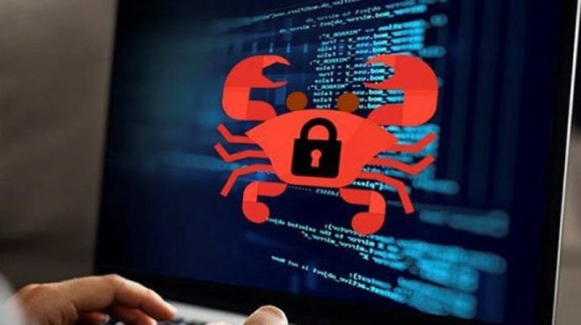
Overview
-GandCrab first emerged in January 2018 and is one of the most successful forms of ransomware
-The creators of this ransomware are very active and have released at least five versions of the GandCrab to date and currently on version 5.2
-CrowdStrike researchers believe the creator of the ransomware is the PINCHY SPIDER group. PINCHY SPIDER is a well-funded and organized group where they were recruiting Remote Desktop Protocol, corporate spamming and virtual network computing skills on dark web forums
-The ransomware are spread through emails attachment and once the person click or execute it, it will start encrypting files and demand for cryptocurrancy in exchange for decryption key

Slide 3
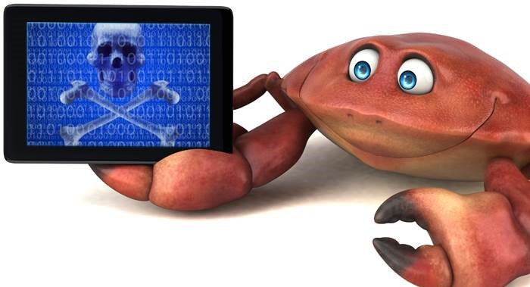
Impact
-PINCHY SPIDER group also partner with Hackers where they allow the Hackers to plant their GandCrab ransomware in the victim system and split a 60/40 share
-GandCrab is the first ransomware that accept DASH cryptocurrency. Dash is basically a forked Bitcoin protocol that enables faster transactions that are untraceable.
-FABEN OB-GYN medical group recently notified 6000 patients that their data was permanently lost due to a GandCrab ransomware hack.
-The price for the decryption key start at $500 and double every day for. For large targeted organization, the cost could be as much as $700,000
-According to Bitdefender, the creator is estimated to have made more than $300 million

Slide 4
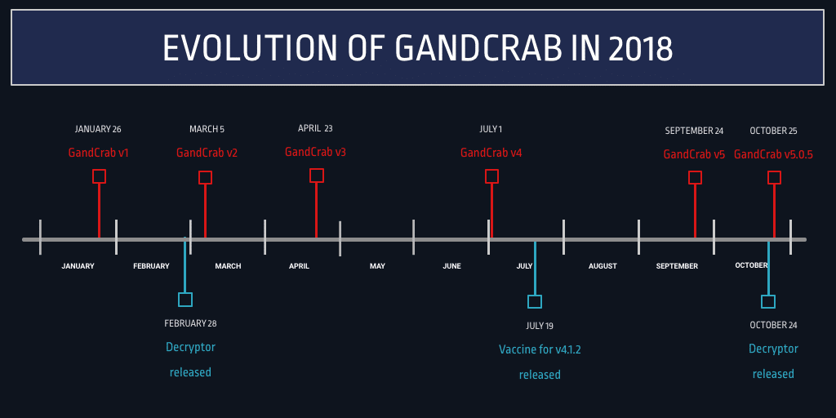
Notes:
I inserted this to get a general purpose of when it started and the rate of updates since version 1. Don't know what section this falls under but it's helpful I think.

Slide 5

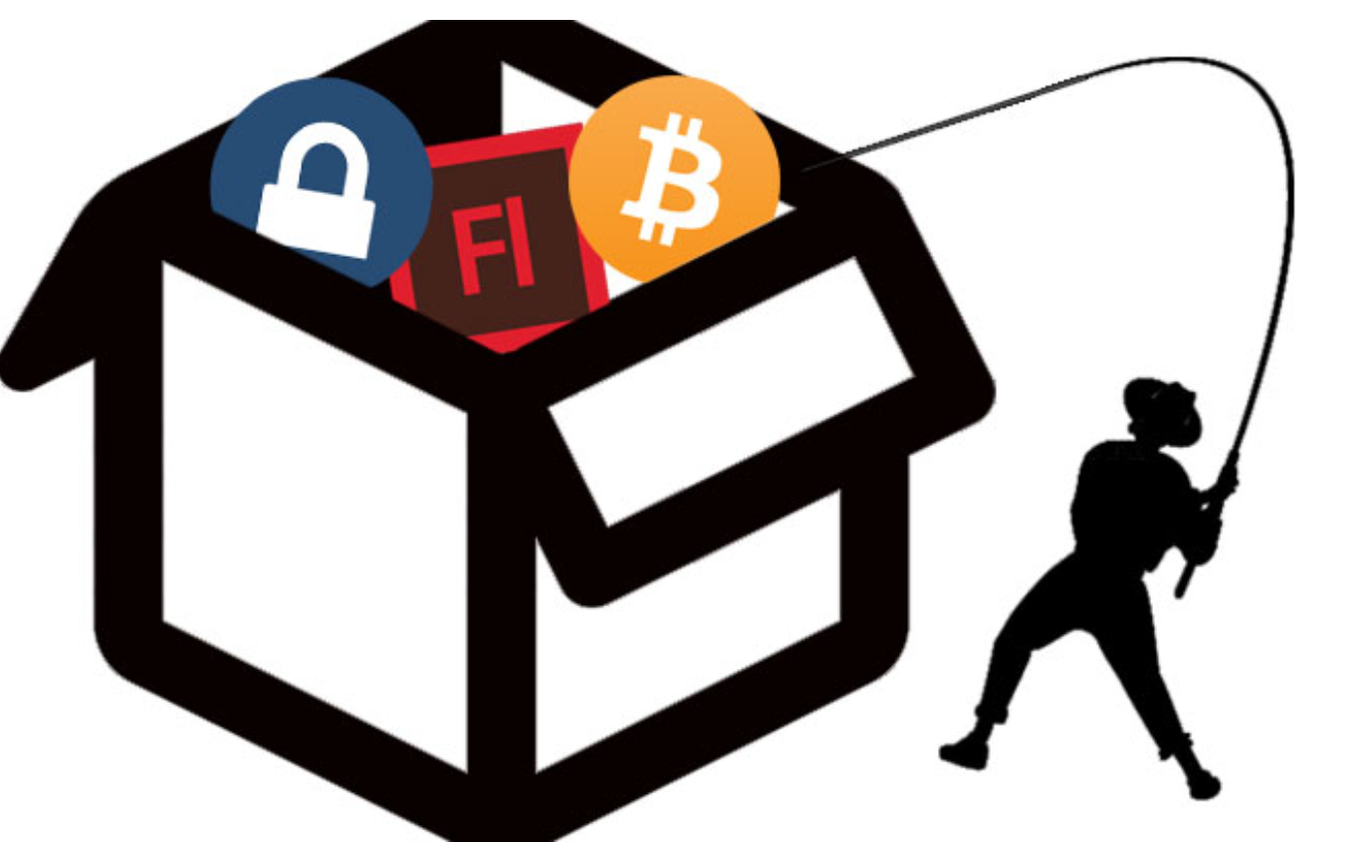
Step 1: Entry point
Email Spam
Exploit Kit
Grandsoft EK
RIG EK
Finds vulnerabilities in
Flash
Java plugin
Silverlight
Fallout EK
Malvertising

Slide 6
GANDCRAB & RANSOMWARE KEYWORDS
ARP – Address Resolution Protocol: Network Flooding
LLMNR – Link-Local Multicast Name Resolution – Protocol based on DNS packet allowing IPv4 & IPv6 hosts.
NBNS – NetBIOS Name Service a.k.a WINS (Windows) Typically UDP transport Protocol @ 137. Serves similar purpose as DNS // Translating human-readable names to IP addresses.
SSDP - Simple Service Discovery Protocol - Protocol transport and addressing as text based on HTTPU on UDP @ 1900. Announces hosting systems with multicast.
ICMP - Internet Control Message Protocol – Responsible for error messages, unavailable requests, unreachable hosts, routers, etc

Slide 7
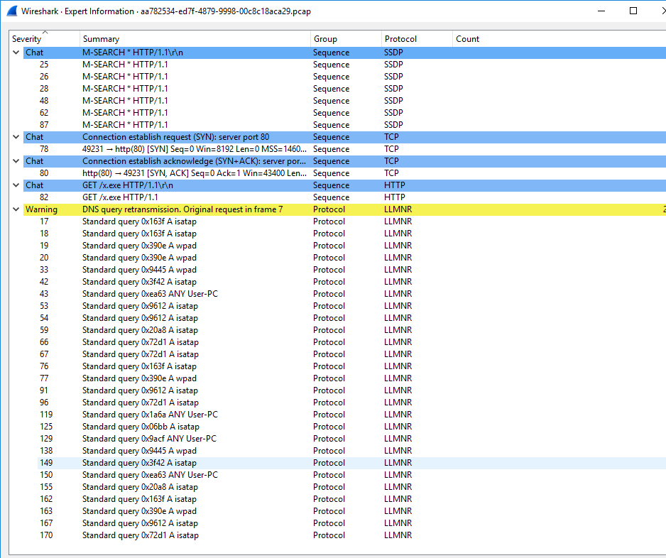
PACKET ANALYSIS
GANDCRAB'S PACKET ANALYSIS
TCP HANDSHAKE & HTTP GET/x.exe
(REFLECTIVE) DLL INJECTION // PAYLOAD
POWERSHELL EXECUTION
GANDCRAB ENCRYPTION
LAN & WAN ESCALATION
EXPUNGED PRIVATE KEY
INFECTS LOCAL MACHINES
PERMEATING EXPONENTIALLY

Slide 8
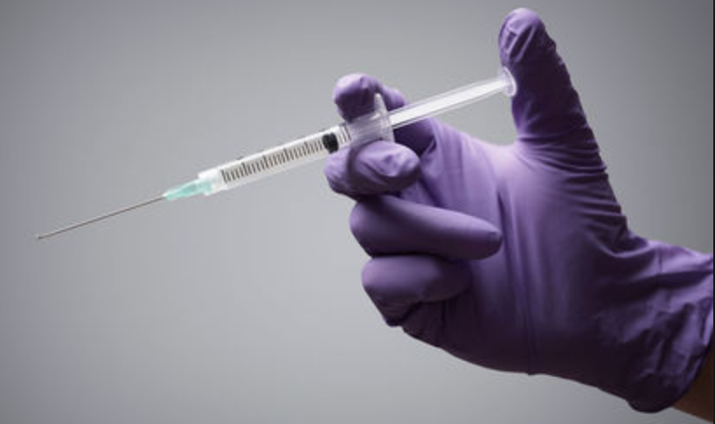
Step 2: DLL injection/Reflection

Slide 9
DYNAMIC & STATIC LINKING ON WINDOWS
STATIC LINKING – Once the program is compiled, effectively copies every function referenced within the executable code.
STATIC LINKING SHORTFALLS - Once files and functions are copied, takes up double the amount of memory.
MALWARE SOLUTION – DYNAMIC LINKING
WINDOWS DLL – Dynamic DLL library have own memory space exists independently of other executables.
EXECUTABLE – DLL library called, dynamic linking shares the memory space.

Slide 10
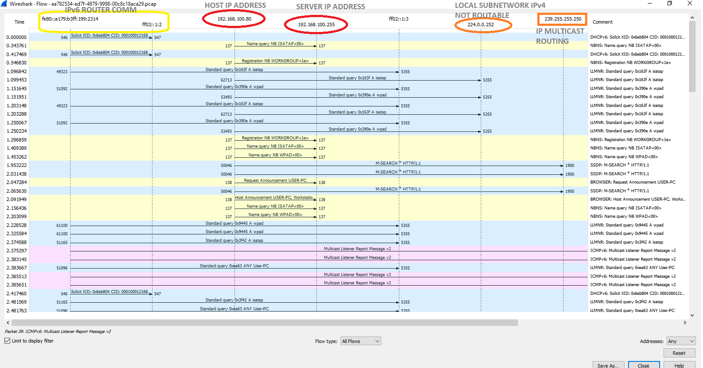
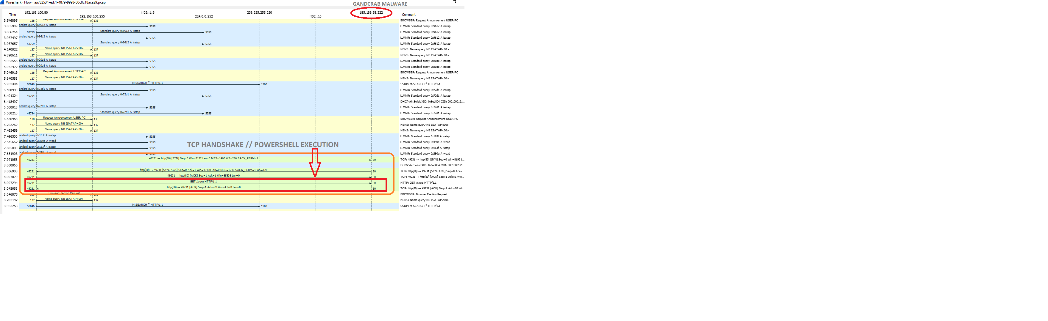
WIRESHARK COMMUNICATION TIMELINE

Slide 11
DLL & REFLECTIVE DLL INJECTION
GANDCRAB UTILIZATION OF REFLECTIVE DLL INJECTION.
DLL – CODE LIBRARY (LOCALLY ACCESSIBLE).
DLL FILES CONTAIN PROCESSES THAT MULTIPLE PROGRAMS CAN CALL ON AS NEEDED DURING RUN TIME. EXECUTION OF MALICIOUS DLL BY WRITING PATH THAT CAN BE TRIGGERED. (Usage of Microsoft programs without any detection.)
REFLECTIVE DLL INJECTION EXPLOITATION – REPLACEMENT OF EXISTING DLL FILES. COPYING ENTIRE DLL INTO PROCESS MEMORY TO AVOID DLL ON DISK AND PROCESSES THAT MALWARE IS BEING INJECTED INTO.
REFLECTIVE DLL INJECTION LOADED FROM MEMORY NOT DISK.
OVERTAKES POWERSHELL AND WMI TO MOVE LATERALLY TO CONNECTED MACHINES.
MICROSOFT OFFICE COMMONLY USED, ACCEPTED AND EASILY WEAPONIZED.
APART FROM MICROSOFT AND iOS, LINUX OS IS THE SAFEST TO NOT BE INFECTED.

Slide 12
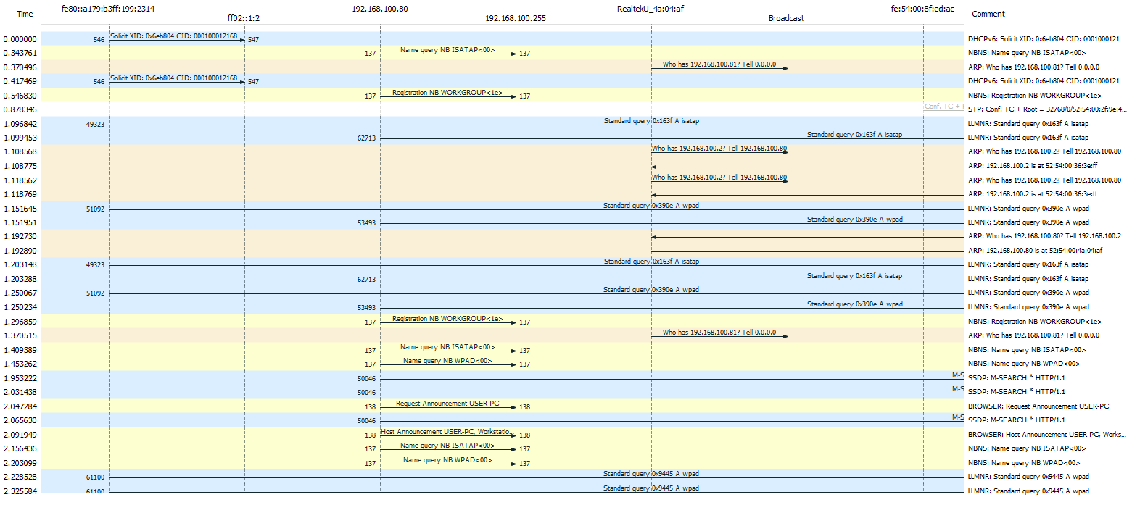
DLL INJECTION timeline

Slide 13

Step 3: Powershell

Slide 14

Step 4: .bit TLD
NOT recognized by the Internet Corporation for Assigned Names and Numbers (ICANN)
but is instead managed by NameCoin's decentralized domain name system.
"Like bitcoins, Namecoin names are difficult to censor or seize."
Example: gandcrab.bit
C2 Server

Slide 15
Step 5: Client iP captured
Computer information captured (name, system info, etc.)
IP of client is also identified using http://ipv4bot.whatismyipaddress.com/

Slide 16

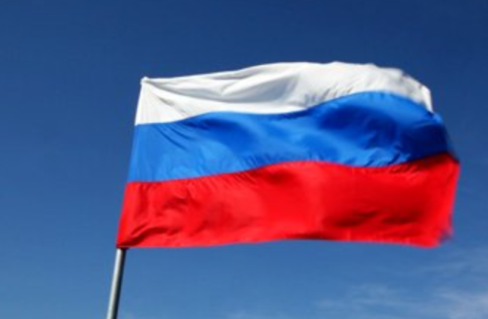
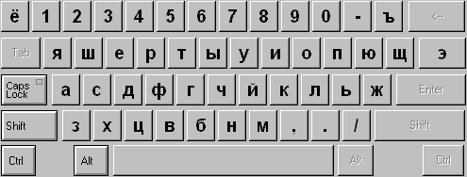
Step 5: GandCrab reconnaissance
Scans the entire file system of the computer
If the computer is identified as Russian, the execution stops

Slide 17
Step 6: Terminate Processes
close any file handles that are open by these processes so that they can be properly encrypted.
msftesql.exe, sqlagent.exe, sqlbrowser.exe, sqlservr.exe, sqlwriter.exe, oracle.exe, ocssd.exe, dbsnmp.exe, synctime.exe, mydesktopqos.exe, agntsvc.exeisqlplussvc.exe, xfssvccon.exe, mydesktopservice.exe, ocautoupds.exe, agntsvc.exeagntsvc.exe, agntsvc.exeencsvc.exe, firefoxconfig.exe, tbirdconfig.exe, ocomm.exe, mysqld.exe, mysqld-nt.exe, mysqld-opt.exe, dbeng50.exe, sqbcoreservice.exe, excel.exe, infopath.exe, msaccess.exe, mspub.exe, onenote.exe, outlook.exe, powerpnt.exe, steam.exe, thebat.exe, thebat64.exe, thunderbird.exe, visio.exe, winword.exe, wordpad.exe

Slide 18
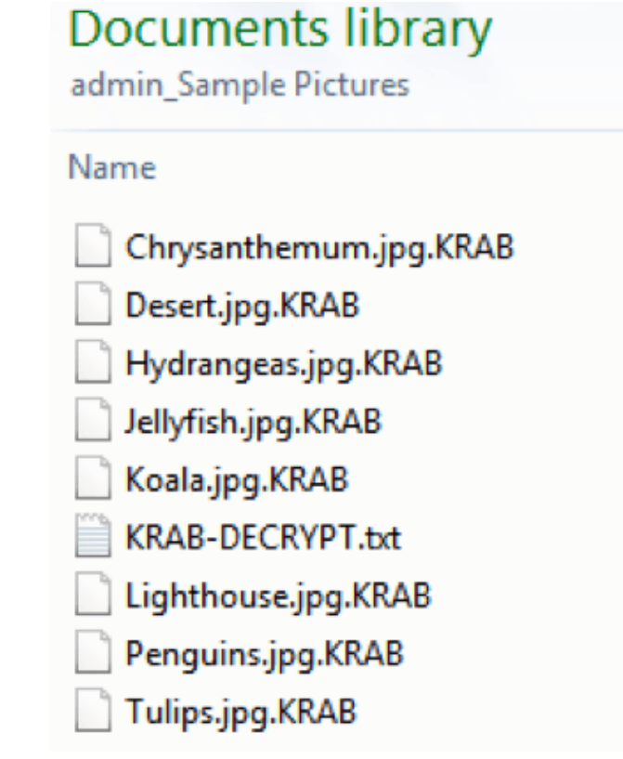
Step 7: Encryption
Files with certain extensions will get encrypted
1cd, .3dm, .3ds, .3fr, .3g2, .3gp, .3pr, .7z, .7zip, .aac, .ab4, .abd, .acc, .accdb, .accde, .accdr, .accdt, .ach, .acr, .act, .adb, .adp, .ads, .agdl, ...
Version 1 gives the .gdcb extension
Version 2 and 3 give the .crab extension
Version 4 gives the .krab extension
Version 5 gives a randomized 5 letter extension

Slide 19
Encryption Process
generates an ephemeral RSA 2048-bit key pair on the machine
AES 256-bit encryption for each file.
Each file has a unique AES key and IV (Initialilzing Vector)
The RSA Private key is converted to Base64 then encrypted with RC4 and then the RC4 key is used as object name to open a new HTTP request handle for connecting to GandCrab’s control server.

Slide 20
Containment strategy

Slide 21
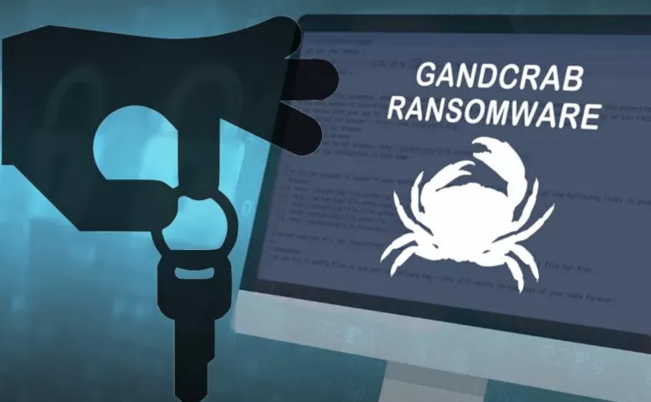
SCOPE
Systems affected: Windows
Attacks usually begin with an attacker entering a victim's network by brute-forcing credentials of a computer with open RDP (Remote Desktop Protocol) ports.
Once the attackers are in, they usually move laterally to a computer that is typically not protected by any anti-virus and launch their attack, spreading the ransomware to any computer on the network.

Slide 22
Severity
Immediate action should be taken to stop any damage or prevent further damage from happening.
Once infected, all files will be encrypted and can only be decrypted by either paying the requested ransom or by using a decryption tool that has been provided by BitDefender (not all versions can be decrypted).
The computer will become completely inoperative unless the ransom is paid or decryption key is used.
The amount of time to pay the ransom varies, usually doubling in price in 24 hours to 1 week.

Slide 23
What to patch
Disable AutoPlay to prevent the automatic launching of executable files on network and removable drives, and disconnect the drives when not required. If write access is not required, enable read-only mode if the option is available.
Turn off file sharing if not needed. If file sharing is required, use ACLs and password protection to limit access. Disable anonymous access to shared folders
Configure your email server to block or remove email that contains file attachments that are commonly used to spread threats, such as .vbs, .bat, .exe, .pif and .scr files.
Turn off and remove unnecessary services. By default, many operating systems install auxiliary services that are not critical. These services are avenues of attack. If they are removed, threats have less avenues of attack.

Slide 24
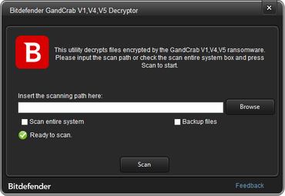
Solution
HOW TO USE THE RECOVERY TOOL
https://labs.bitdefender.com/2018/10/gandcrab-ransomware-decryption-tool-available-for-free/
Step 1: Download decryption tool
Step 2: Run utility : Will be saved as BDGrandCrabDecryptor.exe
Step 3: Agree to terms and conditions
Step 4: Select Scan entire system (select backup all files)
Step 5: Your files will be decrypted and you will see both encrypted and decrypted files.

Slide 25
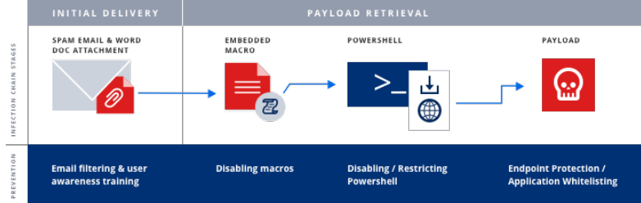
INFECTION VECTOR PREVENTION
Learn Russian- use a Russian keyboard
EMAIL: BLOCK COMMONLY ABUSED FILE TYPES
.vbs, .js .exe, .jar, .html, .htm, .wsf, .bat, .lnk, .zip, .7z, etc
WEB:
WEB FILTERING
AD BLOCKING
PATCH MANAGEMENT
RDP (REMOTE DESKTOP PROTOCOL):
RESTRICTION VIA FIREWALL // RDP GATEWAY // VPN
STRONG PASSWORDS AND 2FA
LIMIT USERS USING RDP
ACCOUNT LOCKOUT POLICY

Slide 26
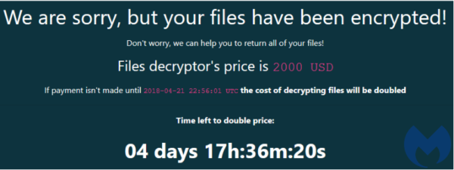
Identification

Slide 27
DO NOT PAY THE RANSOM!!!!!
Payment does not guarantee you'll receive the key you need.
Do not to follow the rules of the criminals since there are alternative ways how you can get back the access to your files or use the decryptor developed by the experts.
If you pay the ransom the virus will continue to spread.

Slide 28
What you should do next
Disconnect from the network.
Since it spreads through emails notify everyone who receives emails not to click the infected email.
Notify the cyber security professional. They will then Google how to fix it.
Back up all your files on external hard drives.

Slide 29
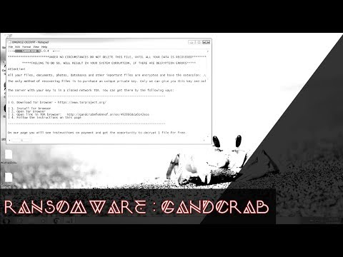

Slide 30
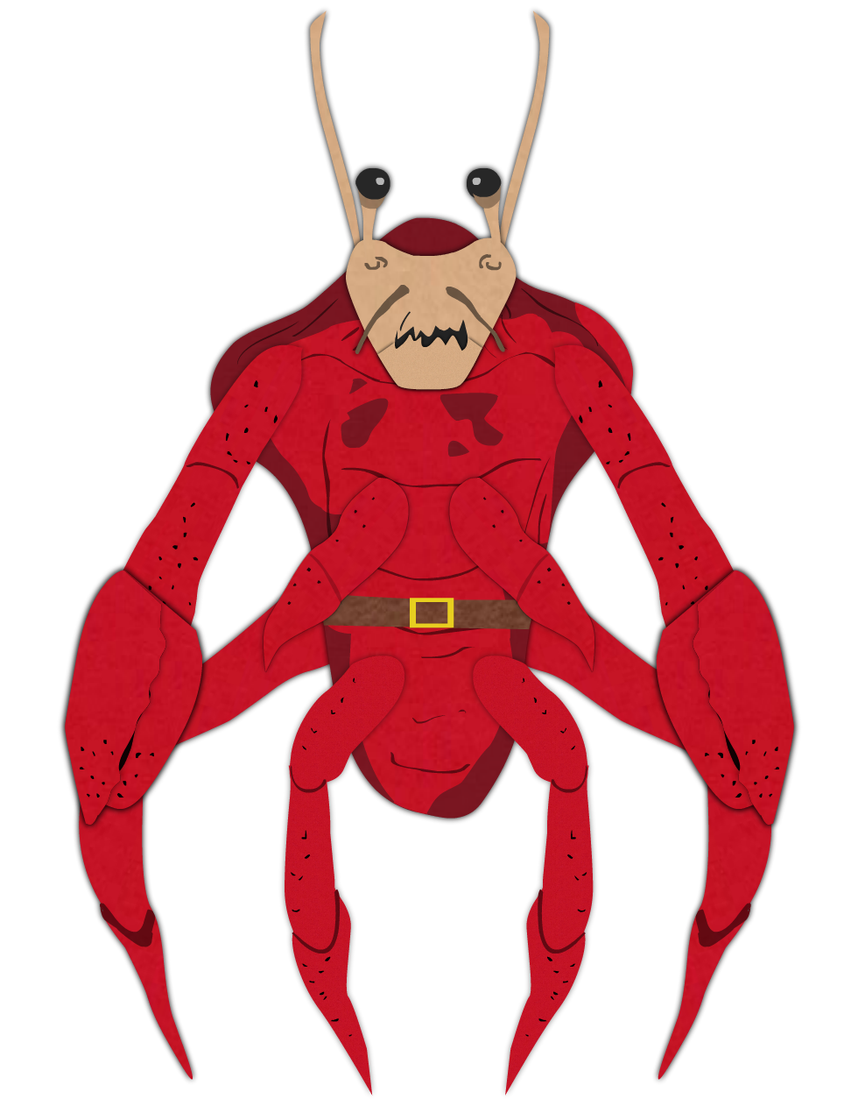
questions?

